Slide 1
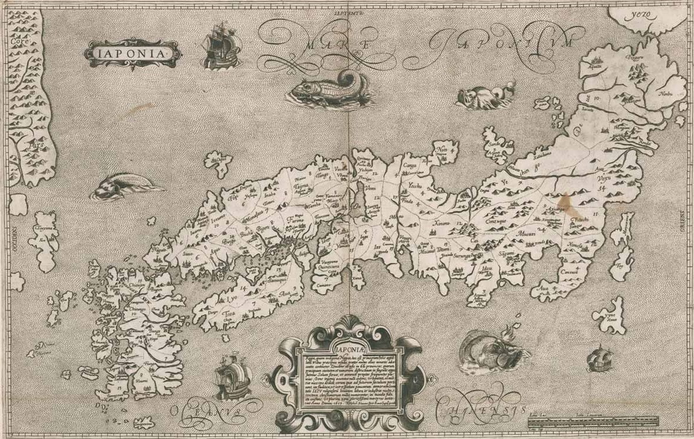
Mapping meisho:
NLP for Japanese Art History
EWA MACHOTKA,
Stockholm University
KONSTANTINA LIAGKOU,
Athens Technology Center
JOHN PAVLOPOULOS,
Athens University of Economics and Business
Notes:
Ewa: Good afternoon, my name is Ewa Machotka and I’m Associate Professor at Stockholm University. I’m an art historian specializing in Edo ukiyo-e prints and I’m here together with Dr. John Pavlopoulos from Athens University of Economy and Bussiness, and Konstantina Liagkou from Athens Technology Center. John and Konstantina are computer scientists and specialists in Machine Learning and Natural Language Processing. All 3 of us will present today to embody the collaborative spirit of the DH projects, as stressed yesterday by Prof. Kitamoto. We will present the results of the first phase of our project on mapping meisho (or famous places) depicted in early modern prints through Natural Language Processing tools, focusing on challenges and solutions inherent to this type of interdisciplinary work.

Slide 2
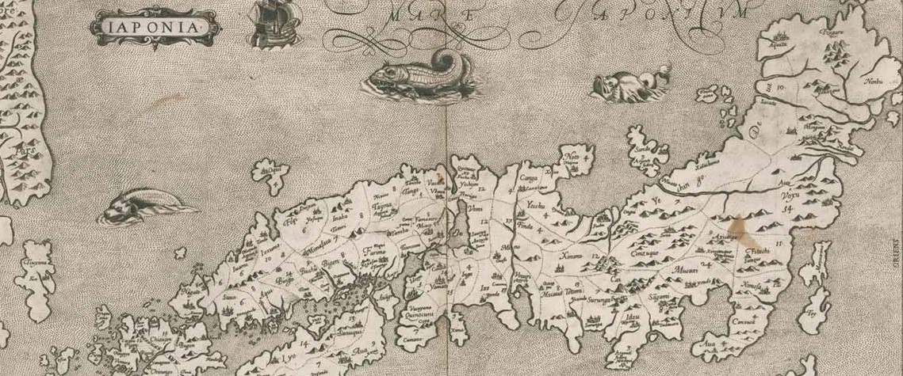
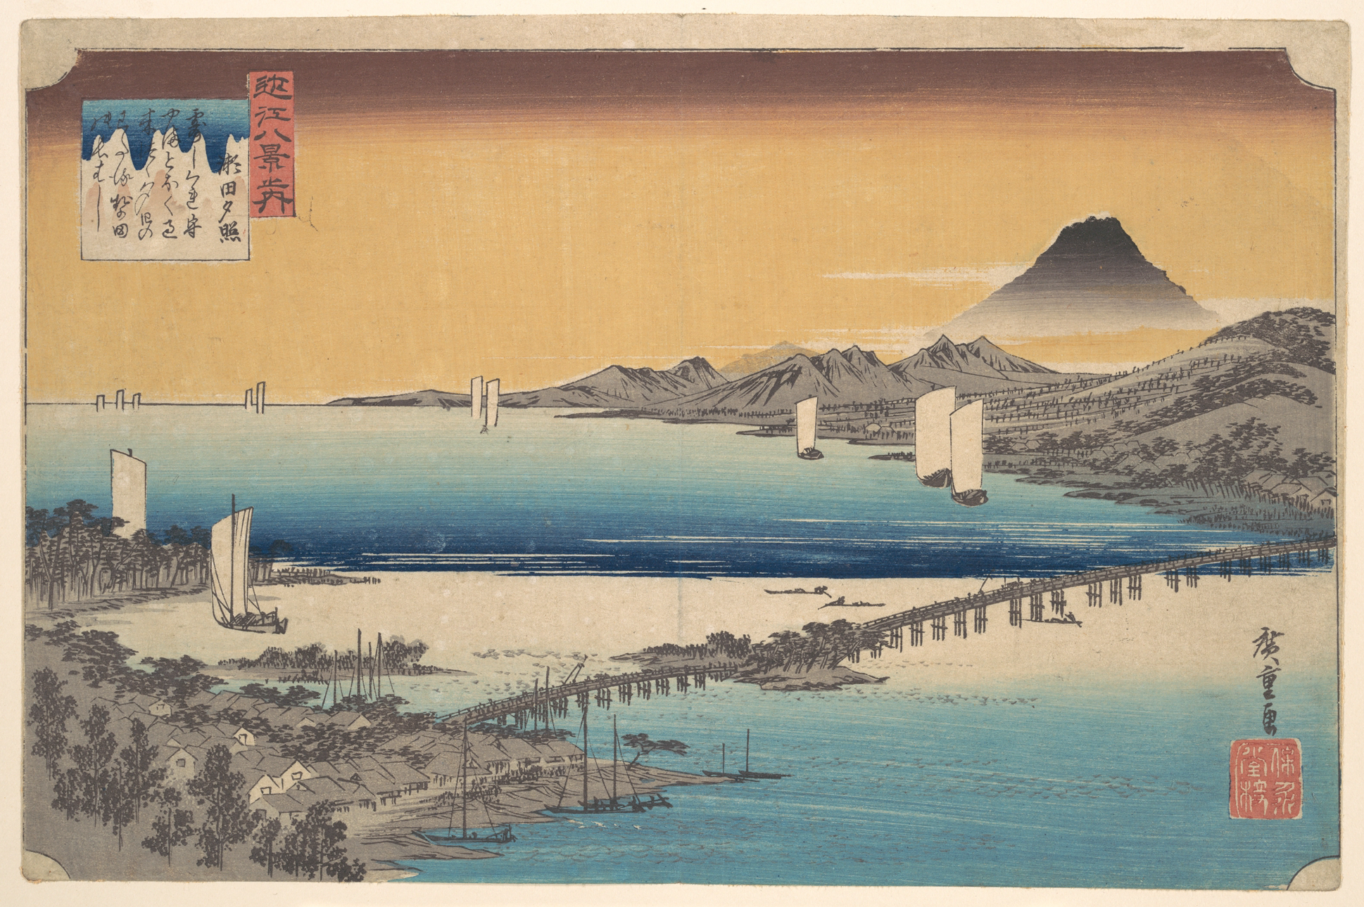
Research rationale
Utagawa Hiroshige (1797-1858),
瀬田夕照 (Sunset Glow at Seta), from the print series
近江八景之内 (The Eight Views of Ōmi, 1834-35), multicolour woodblock print, MET (OA).
Notes:
Ewa: As we all know, Japanese early modern woodblock prints depicting views of the countryside, so-called meisho-e (images of famous places), such as this one by Hiroshige from his series Ōmi hakkei (Eight Views of Ōmi), are often defined today as fūkei-ga, or landscapes. But the notion of fūkei is a modern cultural translation entangled with the ideology of modernization and colonial power (as discussed by Karatani). So, the concept of fūkei obscures the specificities of Japanese visual culture and the intricacies of early modern spatiality or a socially produced space.
In fact, originally meisho-e were rooted in utamakura or poetic rhetorical figures that tie seasonal images with particular (real or imagined) places. So, to understand these images and their social function, we need to understand their relationships with actual geography of Japan.
To address these issues we have engaged with so-called ‘distant viewing’ or macroanalytical study of the relationships between places depicted in prints executed between 1800-1850, and Japan’s geography. Considering the richness of the corpus (including thousands of objects) this study was aided by computational technologies capable of crunching large visual datasets.

Slide 3
Research questions and goals
Theoretical questions:
1) What kind of places are depicted in meisho-e prints?
2) How are these places distributed across Japanese territory?
3) How do these constellations of places change depending on time, artist, publisher, format etc.
NLP questions:
1) How accurate is the recognition of named-entities of inscriptions on prints?
2) Opt for machine learning or gazetteer -based NER?
2) Will NER work on noisy input, such as recognised inscriptions?
Notes:
Ewa: In our prior work we have experimented with automated harvesting of geospatial data from the image-content-related inscriptions on prints (using human-made transcriptions). In this follow-up work, we undertake large-scale automated mapping of meisho extracted from incriptions to see: 1) What kind of places are depicted in meisho-e prints (and are considered significant)?
2) How are these places distributed across Japanese territory?
3) We would also like to know how do these constellations of places change depending on time, artist, publisher, format etc. but this is a future endeavor.
And some questions from the natural language processing side:
1) How accurate is NER?
2) Should NER be based on gazetteers or should we learn a machine to do it?
3) And can NER work on automatically recognised, not transcribed, text?

Slide 4
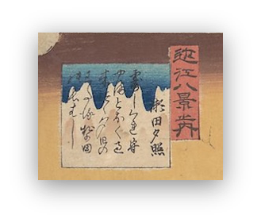

Computational analysis of landscape prints: challenges
Red cartouche features the print series title 近江八景 (The Eight Views of Ōmi) written with kanji,
,
Square cartouche features the print title 瀬田夕照 (Sunset Glow at Seta River) with the place name 瀬田 Seta (Seta River), and a poem related to this place:
つゆ時雨もる山遠く過き來つゝ夕日のわたる勢多の長はし
(Konoe Nobutada, 1565-1614)
Notes:
Ewa: Before we present our experiments we would like to briefly reflect on the main challenges of a computational analysis of early modern Japanese artefacts. As we know, the field of Spatial Art History combining Geographical Information Systems (GIS), Natural Language Processing (NLP) and Corpus Linguistics, have advanced in the past years. However, although these tools perform well on modern datasets it is not the same for historical materials. We can encounter several problems such as OCR errors, place reference identification and place reference disambiguation (related to language changes over time). The situation is even more complicated in the case of mapping meisho-e prints due to the ambiguity of the depicted visual motives.
We need to note that place identification in prints is not always facilitated by iconography or visual motives but by the image-content related inscriptions printed in the images that often feature place names or meisho (lit. famous places). So, geolocating of meisho sites requires reading of inscriptions. Transcription of inscriptions is one of the main obstacles for art historians interested in a large-scale analysis of the prints. This is due to complexity of the Japanese early-modern writing system, adequate identification of place names, and material aspects of a print (e.g. preservation state).

Slide 5
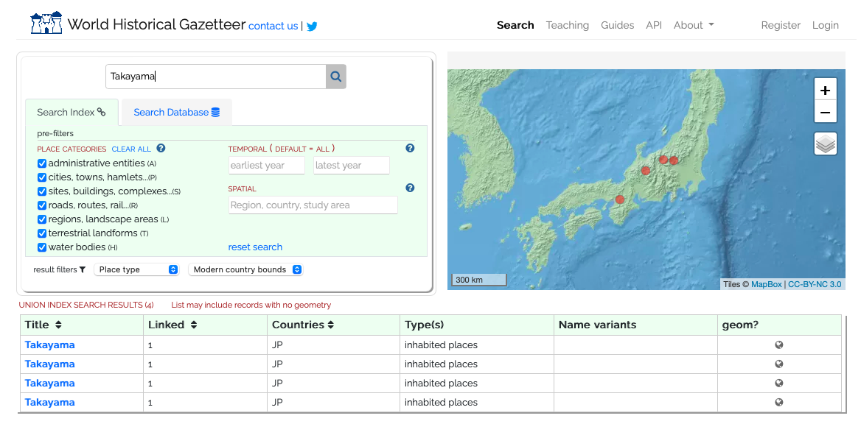
Problems with adequate identification of place names
Notes:
Ewa: I don’t think that we need to explain challenges related to the complexities of the Japanese early-modern writing system (e.g. related to kuzushiji and hentaigana) at this meeting. Instead I’d like to focus on the problems with adequate identification of place names.
The problem is that historical place-names extracted with NER from meisho-e inscriptions are not easily geolocated on contemporary maps of Japan as the retrieval algorithms are trained on contemporary datasets and gazetteers of toponyms (or geographical dictionaries providing information about places).
This is due to several factors related to problems with identification of place names (place reference identification and place reference disambiguation) rooted in historical transformation of Japanese writing systems, and historical changes in administrative geography in Japan (changes of boundaries and renaming practices).
In short, place-names reflect the language and writing systems used at the time when a given name was created. Subsequent linguistic transformations can make place names ambiguous or even unreadable. For example, linguistic reforms conducted in Japan in the modern era, and change in place-names practices in the post-WWII era (e.g. “Indication of Residential Address Law Juukyo Hyouji ni kan suru houritsu 住居表示に関する法律, 1962) made some old historical toponyms forgotten. Also, ambiguity of Japanese place-names is due to their linguistic structure. Place-name is usually rendered in a compound of 2 kanji characters in which one functions as an attribute of a place (e.g. adjective), and one is a noun denoting topographical formation (e.g. mountain, river, valley). As similar type of natural formations (e.g. Takayama 高山 > lit. ‘High Mountain’) can be found in different parts of Japan, it is difficult to disambiguate and geolocate the site.
The problem here is unavailability of comprehensive digital gazetteers of Japanese historical geographical names. The Gazetteer of Japan issued by the Government of Japan does not cover historical toponyms. Scholars such as Prof. Asanobu Kitamoto and Prof. Chikahiko Suzuki conducted important experiments with mapping historical places in Edo (Edo-mi project) and used manually annotated data that are converted to the gazetteer. But this work did not target Japan as a whole.
We can also try to use the World Historical Gazetteer directed by Prof. Ruth Mostern (Univ. of Pittsburgh) that to date hosts about 60,000 temporally scoped place records, which supplies temporal depth to a core list of about 1.8 million place records. But the problems remain the same e.g. if we search for ’Takayama’, the system suggests 4 different locations in Japan.

Slide 6
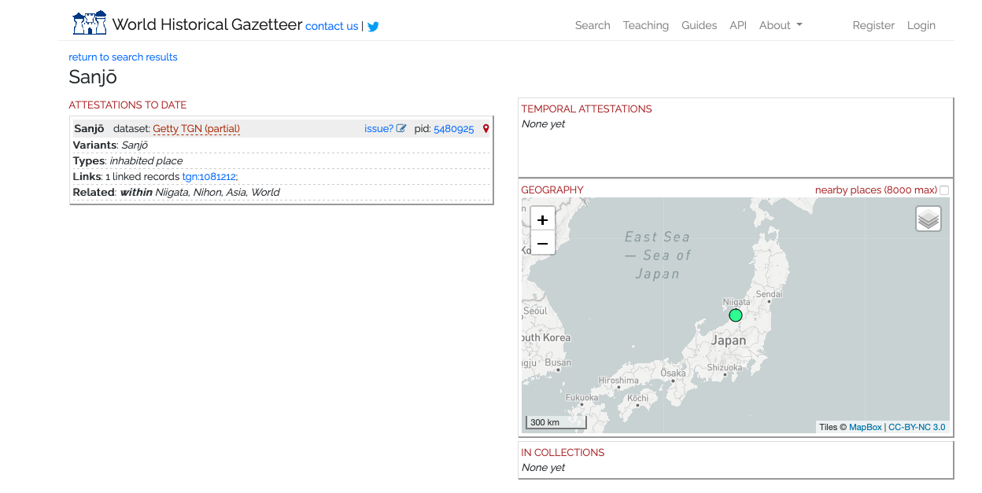
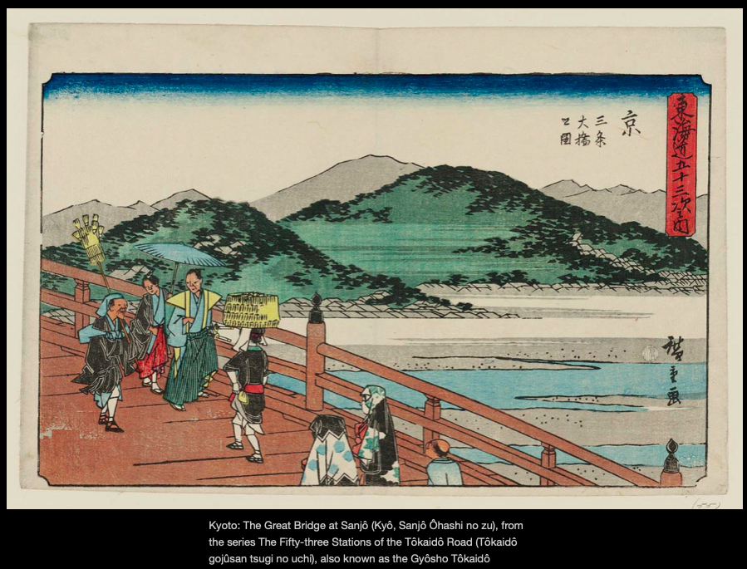
Problems with adequate identification of place names
Notes:
Ewa: Also, if we would like to identify a meisho from Hiroshige’s Tokaido Series from the 1840s (so-called Gyousho Toukaido), Sanjō no ōhashi or the Great Bridge in Sanjō (located as we know in Kyoto) we cannot do it as the gazetteer lacks historical data and directs us to a location in Niigata Prefecture.

Slide 7
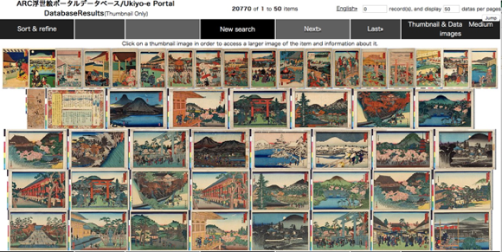
Corpus
Ukiyo-e Portal Database, Art Research Center, Ritsumeikan University, Kyoto (screenshot)
Notes:
Ewa: These problems prompted our study. To conduct ‘distance viewing’ of images we of course needed data. Fortunately, the access to the data for this work was facilitated through our partnership with the Art Research Centre at Ritsumeikan University, Kyoto and support Prof. Akama Ryo. The centre’s digital databases of Japanese culture hosts approx. 700,000 (678,429) objects kept at 28 institutions in Japan and abroad, and is continuously growing. Our study investigated approx. 20,000 (20,408) digitized prints featuring natural environments, issued around 1800-1850s.

Slide 8
Our approach
-Fine-tuned spaCy and BERT
-Evaluation (50-50)
Inter-annotator agreement
Geolocate the detected place-names on the map
NER on OCRed output
2
4
6
8
1
3
5
7
NER on inscriptions of
ukiyo-e prints: LOC & GPE
Re-annotation (#20)
Retrain BERT w/one tag (PLACE: LOC | GPE)
BERT vs. GeoNLP
(LREC 2022)“Distant Viewing of Ukiyo-e Prints.”
Liagkou K., Machotka E. and Pavlopoulos J.
Notes:
John: Thank you, Ewa, in this slide I will outline our approach in steps.
Click: To identify place-names inside inscriptions on ukiyo-e prints, we used a Natural Language Processing approach called Named Entity Recognition. Recognisers are most often trained on annotated data, hence our team member and art historian, Ewa, created LOC and GPE tags for location and geopolitical place-name entities for 200 inscriptions.
Click: Using the one half of this resource, we fine-tuned Spacy and Bert, and we evaluate the two models on the other half.
Click: Also, a second annotator, an expert in Japanese history and language, annotated the inscriptions of 20 randomly prints of the already annotated sample to measure inter-annotator agreement.
Click: Inter-annotator agreement showed that separating LOC from GPE is difficult, so, we merged them into a single tag named.
Click: We then re-trained the best model with the same data but using the merged annotations.
Click: By applying our recogniser on inscriptions of unseen prints we studied the found entities, also geolocating them on a map.
Click: This visualisation, however, made us think that a gazetteer might work better. Hence, we experimented with other tools we could find and we report the outcome.
Click: The last step, then, which brings us to future work involves a hypothesis: that is applying Optical Character Recognition to extract the text of the inscriptions, and assess whether we can recognise places from the recognised, not transcribed text. This step could increase the scale of our study.
So next, I leave the floor to Konstantina, who will give more details.

Slide 9
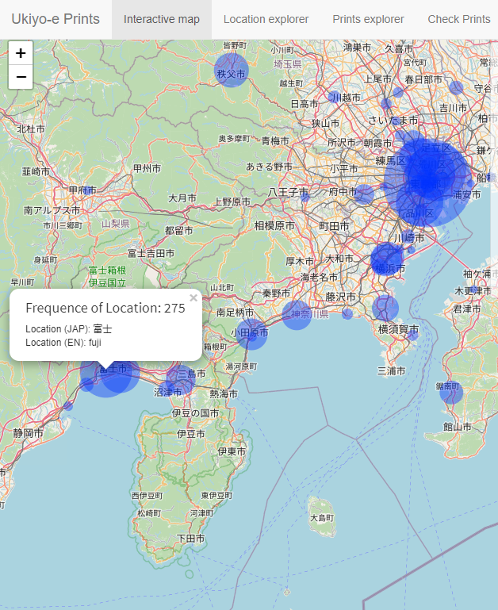
Each is geolocated
20,408 prints with inscriptions
Ukiyo-e Distant Viewer
System-tagged places
Each is geolocated
Then mapped (radio~frequency)
Notes:
Konstantina: Thank you, John. So, starting from the visualisation, you can see here our “Ukiyo-e Distant Viewer”, which presents the entities we extracted from the inscriptions using NLP. Here is how the method works:
click: In prior work, from the around 20,000 digitized prints which arose from our search based on the keyword ‘meisho’ (famous place) and ‘meisho-e’ (image of a famous place),
click: we randomly selected 200 samples to annotate and use them to train and test machine learning algorithms to extract place-name entities. An art historian annotated those prints and we identified 469 places, which are pinned on a map.
click: The size of each pin reflects the frequency of a given place-name.

Slide 10
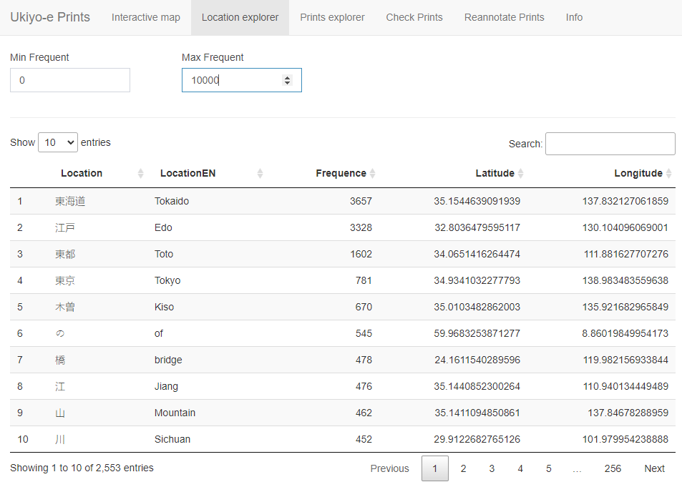
Limitations
Faulty results:
1
names of roads that cannot be geolocated by a single pin e.g. Tokaido
2
place names located outside of Japan e.g. Jiang, Sichuan
3
generic categories of landforms or human-made objects e.g. ‘mountain’ or ‘bridge’
4
grammatical forms e.g. preposition ‘of’
Notes:
Konstantina: We observed, however, that this Viewer did not work perfectly. For example, it included different kind of entities, and not only place-names. Also, geolocation of some entities was faulty.
click:First, it could not geolocate the names of roads such as ‘Tokaido’ that are not pineapple on a map (by a single pin). ‘Tokaido’ was represented as a larger grouping of pins and is located in Aichi prefecture. Also, Tokyo, Kawasaki, and Fujisawa were located on the Izu peninsula. Obviously, this is not geographically correct. So, we decided to exclude place names that are not possible to geolocate by a single pin on a map (such as road names); and we excluded the series titles (e.g. 53 Stations of the Tōkaidō Road) to get a more precise understanding of the frequency of individual place-names.
click:Moreover, we observed that some places were geolocated outside of Japan, like Jiang, Sichuan.
click:The algorithm also picked up generic categories of landforms or human-made objects such as ‘mountain’ or ‘bridge’
click:And grammatical forms such as the preposition ‘of’

Slide 11

Transfer Learning
The Gazetteer of Japan
F1-score
more than 4.000 places
13%
GeoNLP/ GeoLOD (CODH)
"Prefectures of Japan"
"Historical Administrative Area Data Set Beta Dictionary of Place Names"
"Railroad Stations in Japan (2019)"
39%
BERT Name Entity Recognizer
74%
Notes:
Konstantina: Therefore, we decided to compare our ML-based NER with gazetteer-based approaches, which already hold valid latitude and longitude coordinates.
Click: First, we used The Gazetteer of Japan issued by the Government of Japan that includes more than 4.000 modern place-names. As this Gazetteer does not include historical place-names (from the Edo period), it did not detect many places, leading to a (thirteen)13% f1 score.
click: We also applied GeoNLP, a gazetteer-based recogniser that comes bundled with a state-of-the-art geo-tagging algorithm. This was developed by the Center for Open Data in the Humanities (CODH) directed by Prof. Kitamoto. When we applied it, GeoNLP was better, achieving 39% in f1, and it was precise but could not detect all place-names from the Edo period.
click: Our BERT-based NER model achieved 74% F1 score, and it learned to detect historical places that contemporary gazetteers never found, which however are not easy to locate on a map.

Slide 12
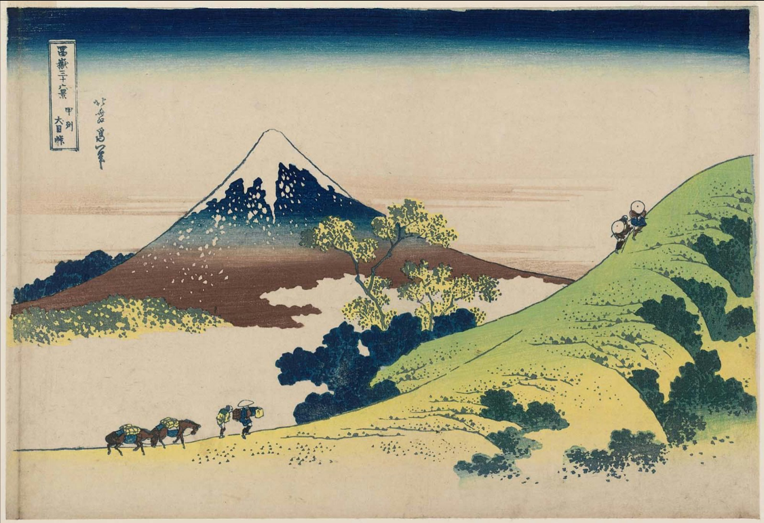
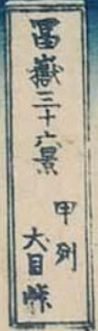

From OCR to NER
Human transcribed
富嶽三十六景 甲州犬目峠
OCR output
富嶽三十六叔 平列大目隊
Cartouche extraction
OCR
NER
富嶽三十六叔 平列大目隊
ukiyo-e print by Hokusai from the series
“Thirty-six Views of Mount Fuji”
Mt.Fuji
Kokusho Sōmokuroku (400k+ 90% pre-modern Edo books)
Less than 1% have been transcribed
Notes:
Konstantina: The final hypothesis regards whether we can first apply OCR and then NER, in order to enrich our primary source of data, moving on to an exploration at a larger scale?
click: To give an example, for this print by Hokusai from the series “Thirty-six Views of Mount Fuji” (Fugaku sanjûrokkei),
the cartouche is extracted
click: and we applied OCR (with brown colour is represented the correct Japanese symbols). Well, we experimented with different OCR models, but we don’t elaborate more regarding their efficiency in this study, as we will follow up in more detail in the near future.
click: Then, we applied NER on the OCRed text
click: and we can see that recognition works relatively fine, with the model recognising “Fugaku” (as you can see with red colour) which is alternative name for Mount Fuji . This is promising given that our model is not trained on OCRed input, which is something we plan to do next. If successful, this application will not only allow a large-scale exploration, but it can also unlock related applications as in the case of early-modern printed books.
click: For instance, the archive of Japanese pre-modern printed books is extremely rich. The general Catalog of National Books, Kokusho Sōmokuroku, alone includes more than 450,000 pre-modern books (Morisue et al. 1963), 90% dated to the Edo period (1600-1868). However, only less than 1% of these books have been transcribed. This is mainly due to the inaccessibility of the pre-modern writing system for contemporary Japanese.
Now, I am giving back the floor to John to tell us more about this road.
----------------------------
to read only if we are asked:
“could we then use OCR, for example trained on our data (prints+inscription transcriptions of prints), in order to transcribe books listed in the General Catalog of National Books and then apply NER to view from distance?”
--------------------
to read if asked:
We experimented with Kuronet, KuLA, RuRA, and Miwo OCR, but here we tried one from another domain. We don’t go into details, because we haven’t experimented enough to bring solid conclusions.

Slide 13
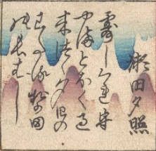
Challenges of automated recognition
Cartouche quality/complexity of key importance
VS
BUT:
Title: 富嶽三十六景 甲州犬目峠
OCR: 蜜嶽三十六叔 平列大目隊
Title:「東海道 京都之内」「大内能上覧図」
OCR: 東海道京都 大内・能上首都市
つゆ時雨もる山遠く過き來つゝ夕日のわたる勢多の長はし
これは２０１６年１２月１６日ともくさまはいくらのこくつけないで――
Notes:
John: Thank you, Konstantina. So this approach is indeed promising, but challenges exist. [click please] When it comes to longer texts such as poems, due to the characteristics of Japanese pre-modern writing system and the formal specificities of the design (e.g., multicolor cartouche), the recognition is largely distorted. The output may only comprise four correct hiragana characters scattered across the inscription. The following question arises, then: is this error affecting the performance of NER models, and if so, can we learn to bypass it? To address this question, we plan to assess NER on OCRed output, in order to quantify the error that is propagated from the recognition of written text to the recognition of named entities. Furthermore, we also plan to invest time and resources in order to improve the written text recognition outcome. For example, one thing we are considering is to join forces with an HTR error correction challenge. [next slide please]

Slide 14
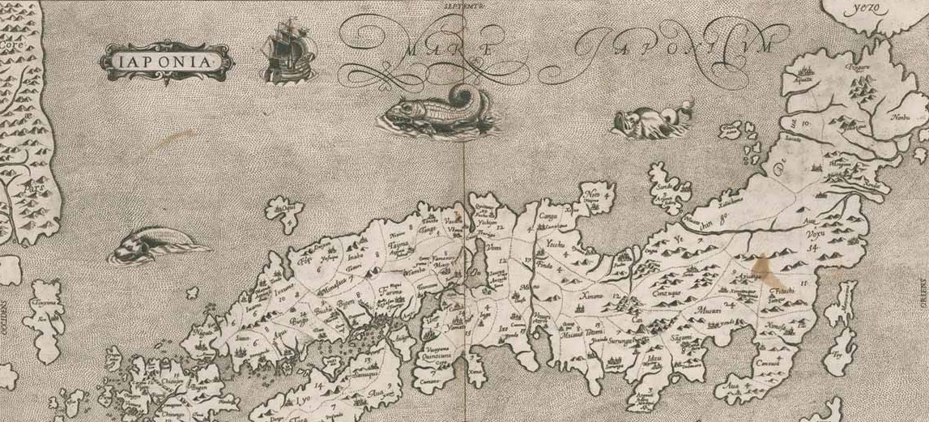
Takeaways
Inscriptions → NER → place names
Opted for ML-based NER
NER on OCRed input is promising
To improve text recognition
Notes:
John: At this point, we can leave some takeaways, starting from the side of machine learning.
1) NLP can help us find place named-entities.
2) Machine learning is the preferred way to proceed, which can also generalise to unseen or noisy input. This brings us to the next point:
3) Can NER work or learn to work on OCRed input? We think so and perhaps this is of interest also to other domains and materials. We plan to quantify this relationship, between OCR and NER, but we are also considering to improve OCR of such inscriptions or the OCRed text though error correction.
And I am giving the floor to Ewa to continue.
Ewa: With this study we also outlined the path for future research that will bring us closer to the understanding of meisho-e images, that should not be confused with landscapes as a modern art genre rooted in Western epistemology of art implicated with Orientalism and colonialism. I trust that in this way, computational tools can play a pivotal role in the development of a truly global art history, pluralistic, horizonal, transcultural and transdisciplinary study of cultural production worldwide.
It does not mean that computational methods are less biased or conceptually less challenging than a traditional humanistic inquiry. Certainly, technology is not a “magic bullet,” and working with digital tools and methods is not “easier” or faster than analogues art history. But, besides many challenges, I think that collaborative spirit and openness specific for the DH work, is its most valuable and enjoyable aspect, certainly worthy of our time and energy.

Slide 15
Thank you!

Slide 16
Appendix

Slide 17
Abstract
Japanese early modern woodblock prints depicting pastoral views of the countryside, so-called meisho-e (images of famous places), are often defined today as fūkei-ga, or landscapes. However, the notion of fūkei is a modern cultural translation which obscures the specificities of Japanese visual culture and the intricacies of early modern spatiality or a socially produced space. To uncover these characteristics and provide a more nuanced understanding of meisho-e prints we have engaged in a macroanalytical study of the relationships between places and topography in prints, aided by computational technologies rooted in Natural Language Processing technologies.
In our prior work we have experimented with automated harvesting of geospatial data from the image-content-related inscriptions on prints. In this follow-up work, we undertake large-scale automated mapping of meisho, and study the geographical distribution of sites featured in these prints. We explore two different computational paths, one rooted in Deep Learning and the other based on a digital gazetteer, and reflect on the challenges and benefits of the applied computational approaches. Our work is also a use-case of a macroanalysis of a visual dataset hosted by the Ukiyo-e Portal Database of the Art Research Center at Ritsumeikan University, Kyoto, which aims to demonstrate the transformative potential of NLP technologies for the study of Japanese early modern prints and Art History at large.

Slide 18
Mask Language Model
4 tokens with the highest probability
次,駅,度,号線
Pretrain Japanese BERT
Perplexity score: 4.66
「
東海道
五
十
三
」
Further train Japanese BERT
Perplexity score: 3.40
Japanese BERT
lower perplexity score
↓
better MLM
「
東海道
五
十
三
[MASK]
」
Further train with
meisho dataset
over 20.000 title
Title:
「 東 海 道 五 十 三 次 」

Slide 19
Transfer Learning
PLACE
F1-score
 | SPACY BERT
GPE | 0.41 0.74
LOC | 0.54 0.54
「
東海道
五
十
三
次
」
Name Entity Recognition
Inter-Annotator
Agreement
tag:
PLACE
Japanese BERT
 | GeoLOD BERT
PLACE | 0.39 0.74
東海道
次
Pre-modern
over NNNNN
Japanese
Symbols
not exist now
「
五
十
三
」
 | BERT BERT Original Further Train
PLACE | 0.41 0.74
Title:
「 東 海 道 五 十 三 次 」

Slide 20
Dataset development
Inter-annotator Agreement (ΙΑΑ)
Micro-averaged Cohen’s kappa
Tags for place-names
Annotations
1
LOC (Location)
Places that were less-easily pinned on a map (e.g. roads, mountain ranges)
42.97%
104
.
78.63%
2
GPE (Geopolitical)
Places that were possible to be pinned on a map (e.g. names of cities, temples, shrines, bridges)
365
78.80%
3
PLACE
All places, merge LOC and GPE
469
Number of tags

Slide 21


